Slide 1
Capstone Project Airbnb Bookings Analysis
Team Project by
Prakshita Agrawal, Deepak Karki
Bhatu Sonawane, Bharat Soni
Sopan Wadekar

Slide 2

TABLE OF CONTENTS
Introduction
Data description and Data pre-processing
Exploratory Data Analysis and Visualization
Inferences and conclusions.

Slide 3

Introduction:
Airbnb
Airbnb is a service that lets property owners rent out their spaces to travelers looking for a place to stay. It simply provides a platform where travelers can rent a space for multiple people to share, a shared space with private rooms, or the entire property for themselves.
How Airbnb Works:
Find your room to stay
Check the details
Make a booking
Pay the rent

Slide 4
Objective:
Numerical
Categorical
Airbnb dataset contains 49,000 observations and 16 columns which specifies about the hosts, customer and places and it is a mix between categorical and numeric values.
Our goal is to explore and analyse the data, provide helpful conclusions through Exploratory Data Analysis build a statistical model that could be used to effectively predict the price for the listings and future decision makings.
id
Reviews per month
neighbourhood
price
name
Room type
longitude
latitude
Neighbourhood_group
Minimum nights
No of reviews
Host name
calculated_host_listings_count
Availability 365
Host_id

Slide 5

EXPLORATORY DATA ANALYSIS
What is Exploratory Data Analysis?
EDA is an approach to analyze the data using visual techniques. It is used to identify trends, patterns, or to check assumptions with the help of statistical summary and graphical representations.
A detailed analysis and pre-processing are done in the dataset. It gave us a better idea of contribution of features towards the target variable.
Why is EDA important?
Explore data
Helps to identify patterns,
Visualize the data,
Understand the features.

Slide 6
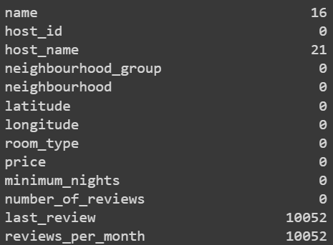
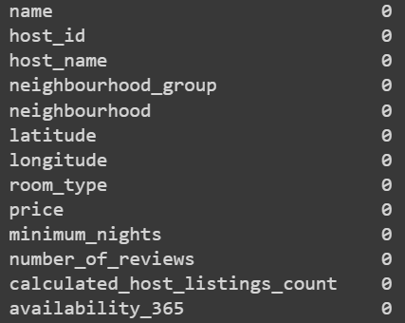
Before treating
Checking for Null values:
It's always better to handle the null values before starting with further analysis in order to get best results.
Columns last_review and reviews_per_month contain many null values. So removed both columns from the dataset
Null values of name and host_name can be filled by fillna method as these are less.
After treating

Slide 7
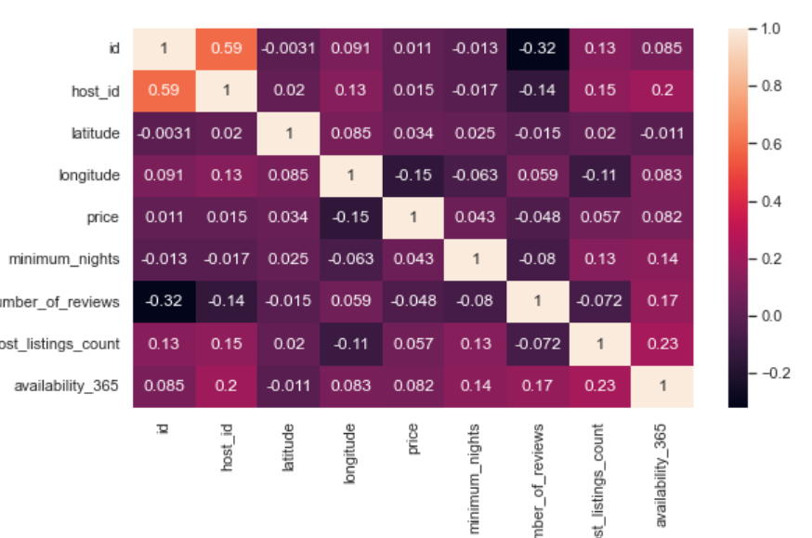
Correlation and Heat map of all variables:
Heatmap gives a correlation matrix to quantify and summarize the relationships between the variables
From the above plot we can see that there is not much observable correlation between variables

Slide 8
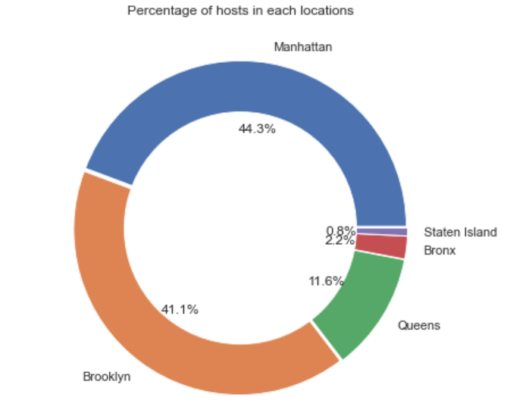
What can we learn about different hosts and areas?
Following points can be understood from the pie chart:
Manhattan and Brooklyn are home to 85.4% of the hosts followed by Queens with 11.6%.
Bronx and Staten Islands are occupied by only 3.0% of the hosts.
It is clear that majority of the hosts are belong to the locations Manhattan and Brooklyn, hence these are the most popular destinations.

Slide 9
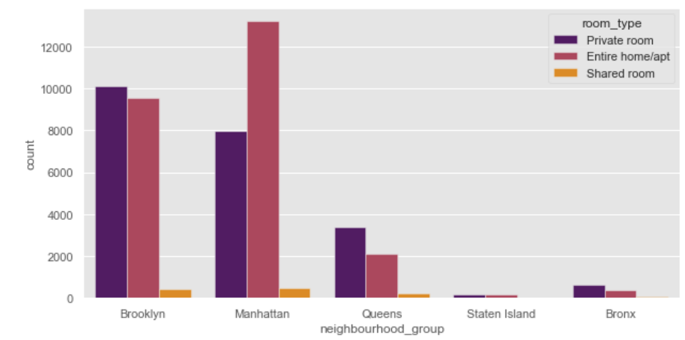
Preferred room type in most popular neighborhood
If people are looking for rooms in these areas of Manhattan and
Brooklyn then hosts are providing either Private room or Entire home/apt.
Shared rooms are least preferred in these areas.

Slide 10
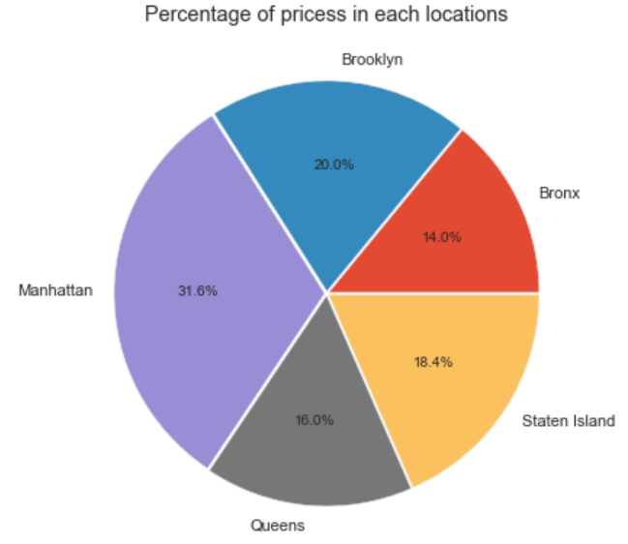
What can we learn from predictions?
Mean price is highest for Manhattan followed by Brooklyn and other locations.
The higher number of hosts present in these areas might be the reason for these high prices.

Slide 11
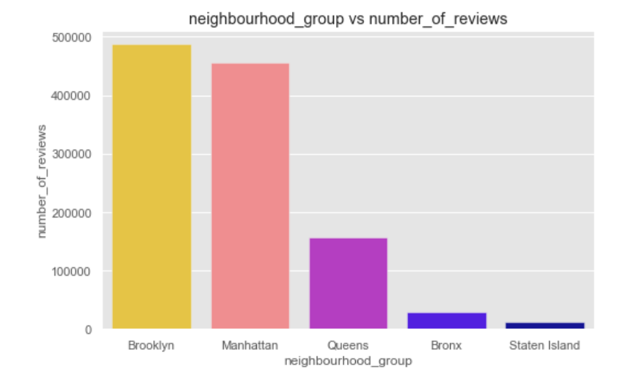
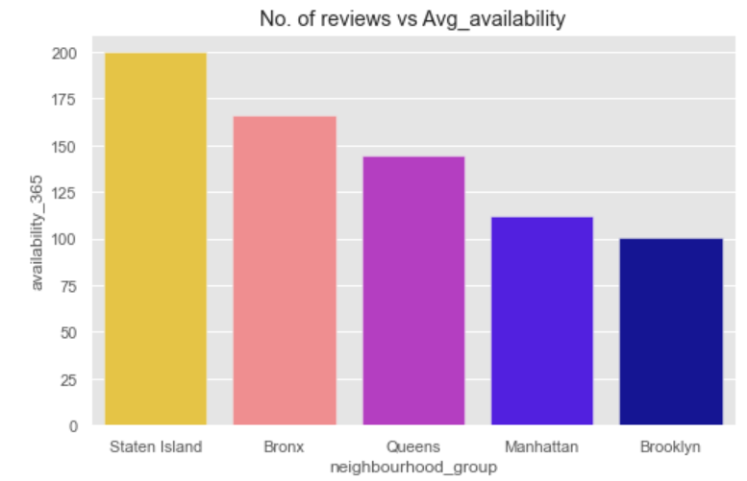
Which hosts are the busiest and why?
Manhattan and Brooklyn receiving the most number of reviews thus making the host busiest
Manhattan and Brooklyn have maximum number of reviews, so offering the most desired room types. Thus for these groups availability of rooms is less.

Slide 12
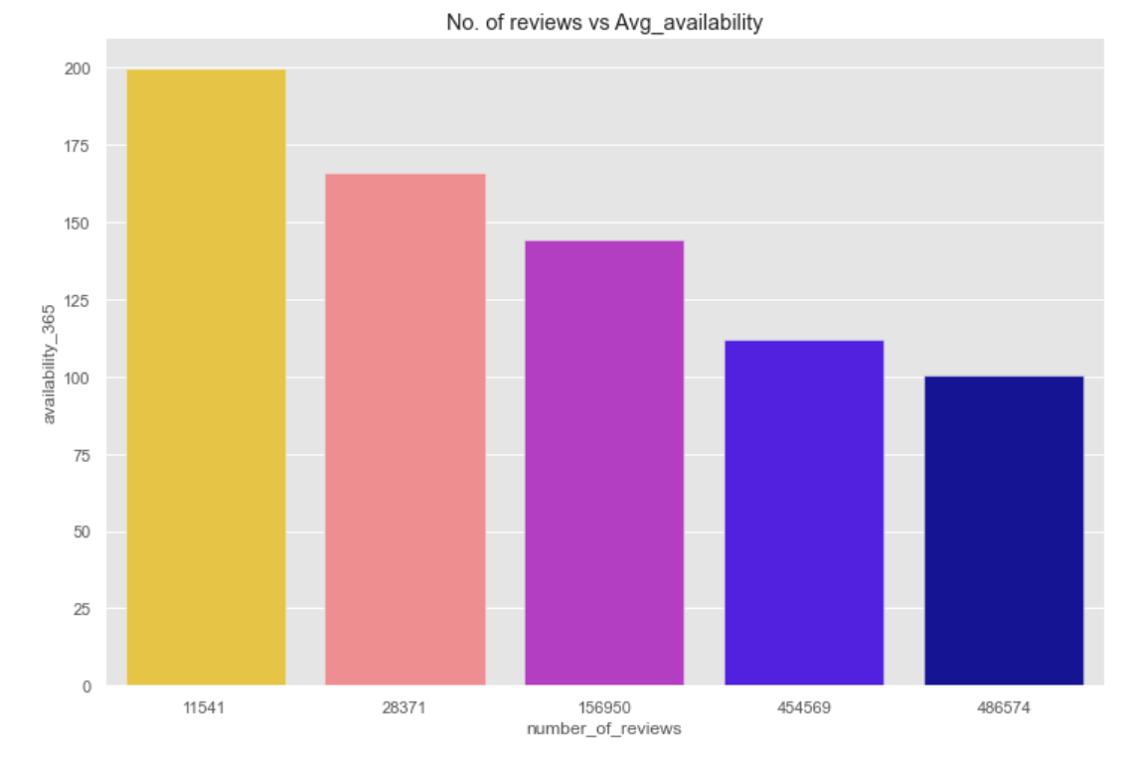
The bar plot shows the relation of number of reviews with the availability of these rooms throughout the year.
This relation shows that as the number of reviews increase the availability decreases.

Slide 13
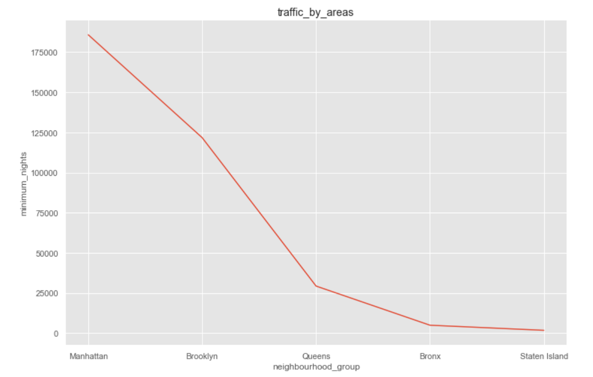
Is there any noticeable difference of traffic among different areas and what could be the reason for it?
A huge difference in the traffic between the different locations. Reasons may be:
Maximum no of reviews
Most preferred room types
More host count

Slide 14
Inferences and conclusions
This Airbnb (NYC 2019) Dataset For The Year 2019 Appeared to be very rich Dataset with a variety of columns that allowed us to do deep data exploration.
In the column name and host_name which have 16 and 21 null value only. Null values are present in last_review and reviews_per_month which can be dropped both have most null values is 10052.
From the dist. plots it can be observed that latitude and longitude data seem to be normally distributed and most of the numeric_features are positively skewed.
People stay for longer duration of time in private rooms in Brooklyn and Manhattan.
More customers preferred Manhattan location for night stay then Brooklyn.
Entire home/apt’room type has the highest number of listing of 52% and shared room is the least listed room type at only 2.4% in total.
63.2% costumer spend night in entire home and 1.6% spend night in shared room.

Slide 15
As the number of reviews go higher the availability decreases indicating that the busiest hosts are the people receiving the most reviews.
Manhattan and Brooklyn are the two top most popular neighborhood groups in terms of hosts count, number of reviews ,number of listing, maximum number of nights spends in these areas. So it might also be reason of traffic and high prices.
For other neighborhood groups namely Queens, Bronx and Staten island there aren't as popular as these two, especially on Staten Island.
Reviews obtained by Manhattan and Brooklyn locations contribute towards the traffic difference, as people tend to book stays with higher number of reviews.
The dataset can be further used for price prediction by building a linear model. The data needs to be treated of outliers and skewness for a linear regression as well as other models.

Slide 16
Thank You

